Slide 1
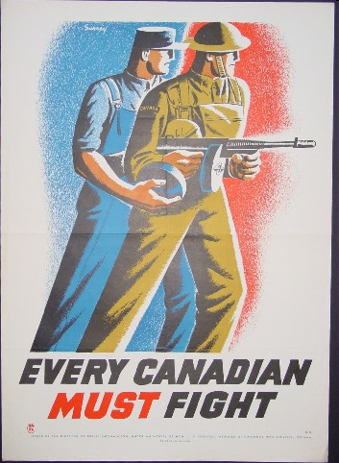
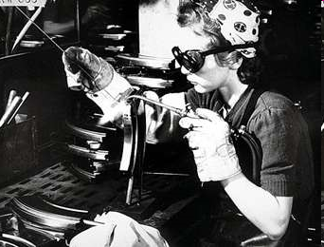
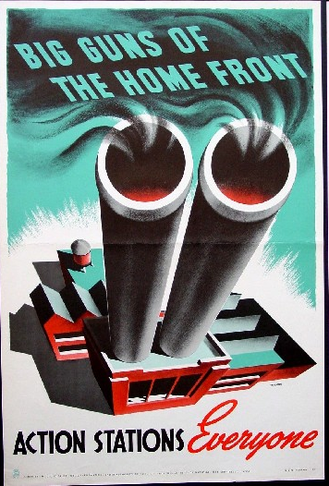
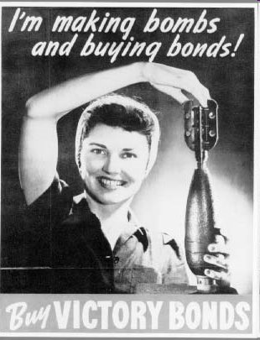
WWII: The War at Home

Slide 2
Total War
By 1942, Canada was committed to a policy of “Total War” which meant that all industries, materials and people were put to work for the war effort.

Slide 3
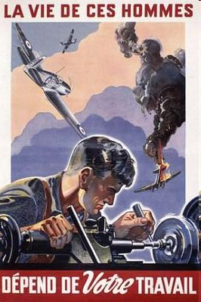
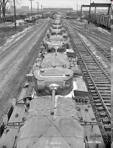
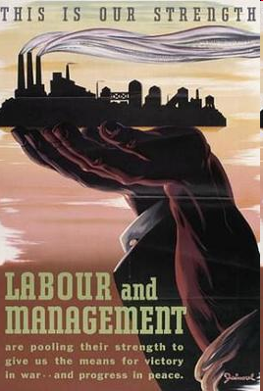
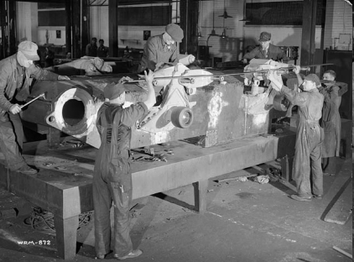
Government and the Economy
The war launched Canada out of the depression and into an economic boom.
Canada became an industrial power: new factories were built and old ones adapted for war purposes. Factories produced thousands of guns, ships, fighter planes and military vehicles.

Slide 4
Labour
With so many men enlisting, Canada faced a labour shortage as early as 1941, most notably in war-related industries.
One of the main strategies of the Canadian Government was to recruit women for the work force.

Slide 5
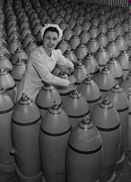
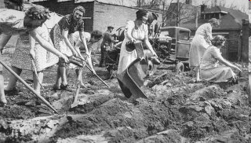
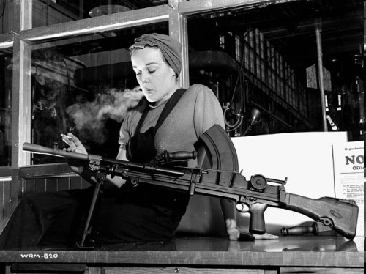
At first only single women were recruited, but upon severe labour shortages, both married women and mothers were sought out; the government even funded daycare centres so that women would be free to work.
In 1943, there were approximately 225,000 Canadian women working in munitions factories.

Slide 6
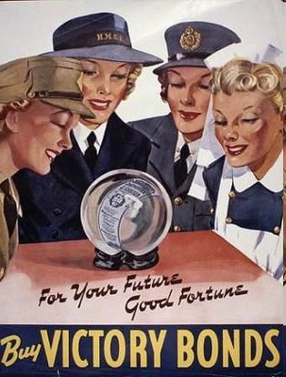
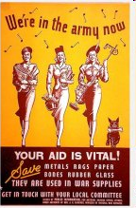
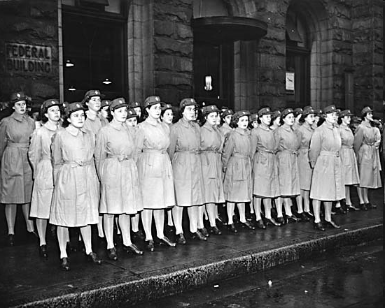
In The Army Now…
In 1941, for the first time in Canadian history, women were able to enlist in their own divisions of the Army, Navy and Air Force.
Although Canadian women were not allowed into combat during the Second World War, they did just about everything else.
Women served as nurses, stretcher bearers, drivers, machine operators, cooks and secretaries. They also flew Canadian built planes to bases in Britain
They were paid roughly 60% of what males in the military were paid

Slide 7
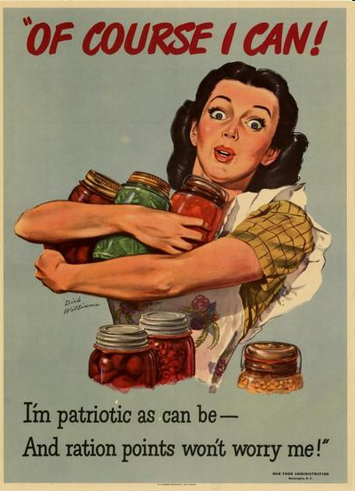
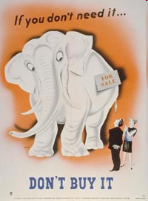
Rationing: A Little Goes a Long Way!
To ensure there was a large enough supply to meet both military and civilian needs, certain staple goods were rationed.
Rationed Items Included:
Meat, Butter, Tea, Coffee, Gasoline, Tires (rubber), Alcohol, Clothing Fabric and Silk

Slide 8
Paying for the War
The Canadian Government did raise taxes during the WWII to help pay for the cost of the war.
The Canadian government turned to an old idea: Victory Bond drives.
The government conducted nine Victory Bond drives between June 1941 and October 1945. These campaigns raised nearly $12 billion by the end of the war.

Slide 9
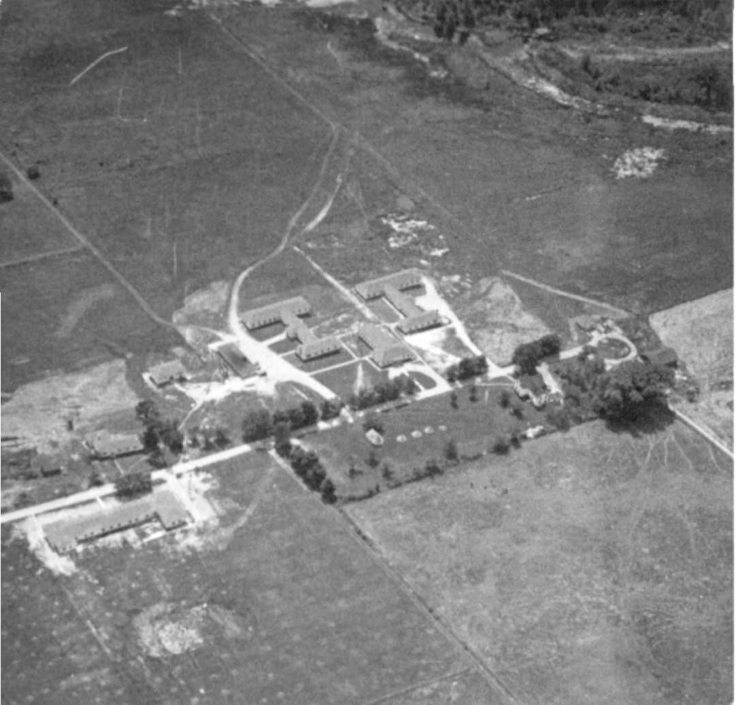
Top Secret: Camp X
Camp X, which operated in Oshawa, Ontario from 1941 to 1946, was a training camp responsible for training recruits for the Special Operations Executive of the British Security Coordination during World War II.
It was comprised of two sections, the Special Training School No. 103, which trained allied agents in the techniques of secret warfare, and Hydra, a network which communicated messages between Canada, United States, and Great Britain.

Slide 10
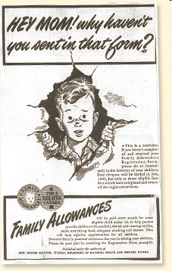
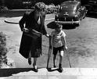
Social Support
In 1940, the government passed the Unemployment Insurance Act. In the face of unemployment, workers could now collect insurance.
In 1944, the government introduced Family Allowance and in 1945 the first “baby bonus” cheques were mailed out.

Slide 11
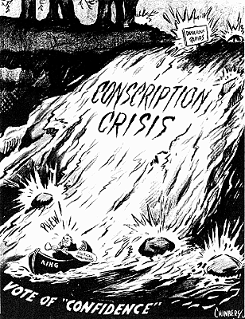
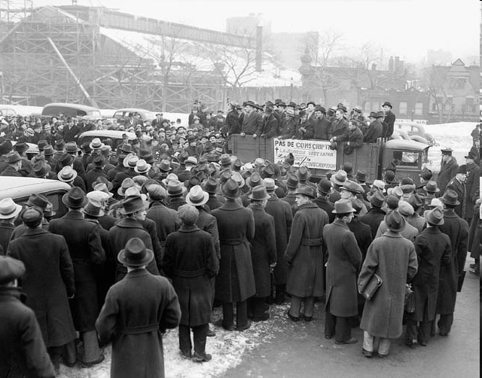
Conscription Crisis: Part II
In 1942, King decided to hold a vote for/against conscription. 80 percent had answered yes out of the nine provinces but 70 percent of Quebec said no.

Slide 12
Prime Minister Mackenzie King was determined not to bring in conscription during World War II.
King promised that conscription would be Canada's last resort
Finally in 1944, after he had tried so hard to avoid it, conscription had been introduced.
Very few recruits from this Conscription campaign actually ended up going to fight in World War 2

